Slide 1


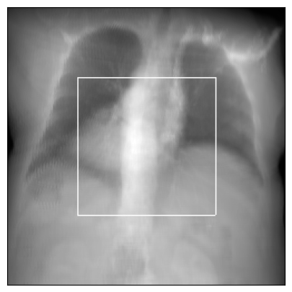
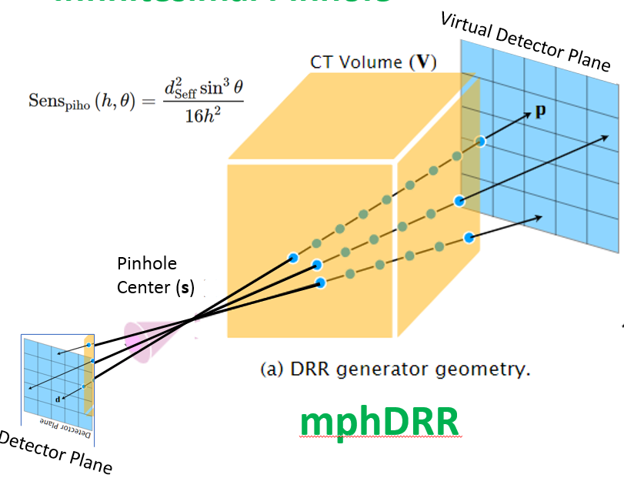
mphDRR in PyTorch: Multiple Pinhole SPECT/’CT’ Digitally Reconstructed Radiographs
Bill Worstell
PicoRad->MGH
1/2/2024

Slide 2
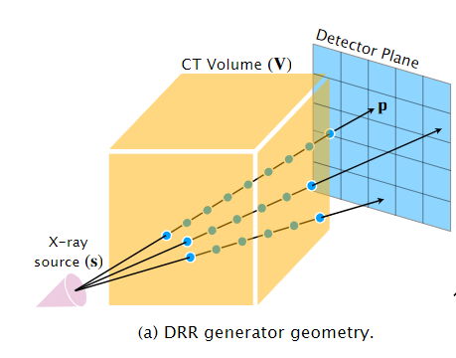

Xray DRR
Gopalakrishnan, V. and Golland, P., 2022, September. Fast auto-differentiable digitally reconstructed radiographs for solving inverse problems in intraoperative imaging. In Workshop on Clinical Image-Based Procedures (pp. 1-11). Cham: Springer Nature Switzerland.
Fig 1b: Multiple Pinhole SPECT DRR system geometry

Slide 3
# Initialize the DRR module for generating synthetic X-rays
device = torch.device("cuda" if torch.cuda.is_available() else "cpu")
drr = DRR(
volume, # The CT volume as a numpy array
spacing, # Voxel dimensions of the CT
sdr=300.0, # Source-to-detector radius (half of the source-to-detector distance)
height=200, # Height of the DRR (if width is not seperately provided, the generated image is square)
delx=4.0, # Pixel spacing (in mm)
).to(device)
# Set the camera pose with rotations (yaw, pitch, roll) and translations (x, y, z)
rotations = torch.tensor([[torch.pi, 0.0, torch.pi / 2]], device=device)
translations = torch.tensor([[bx, by, bz]], device=device)
img = drr(rotations, translations, parameterization="euler_angles", convention="ZYX")
# Initialize the DRR module for generating synthetic X-rays
device = torch.device("cuda" if torch.cuda.is_available() else "cpu")
drr = DRR(
volume, # The CT volume as a numpy array
spacing, # Voxel dimensions of the CT
sdr=vsdr[imod], # Source-to-virtual-detector radius (half of the source-to-virtual-detector distance)
height=500, # Height of the DRR (if width is not seperately provided, the generated image is square)
delx=2.5, # Pixel spacing (in mm)
).to(device)
# Set the camera pose with rotations (yaw, pitch, roll) and translations (x, y, z)
rotations = torch.tensor([alpha[imod],beta[imod],0.], device=device)
translations = torch.tensor([[bx, by, bz]], device=device)
img = drr(rotations, translations, parameterization="euler_angles", convention="ZYX")

Slide 4

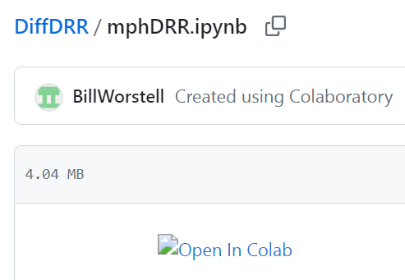
https://github.com/BillWorstell/DiffDRR
https://github.com/BillWorstell/DiffDRR/blob/main/mphDRR.ipynb

Slide 5
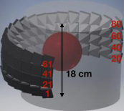
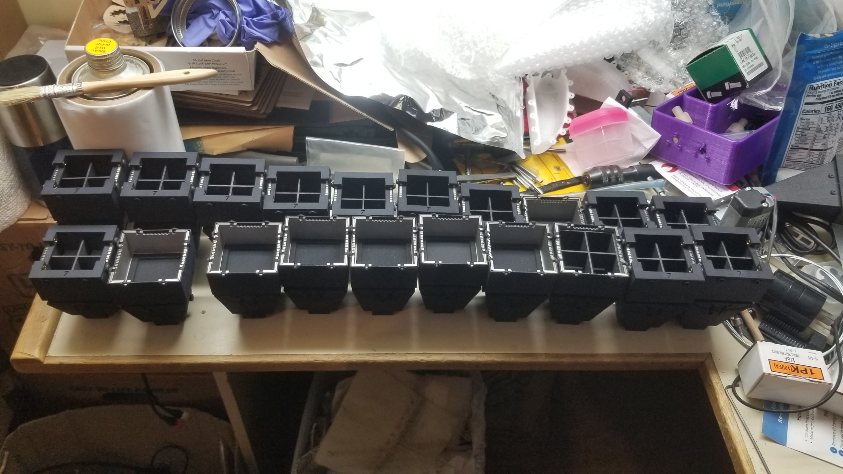
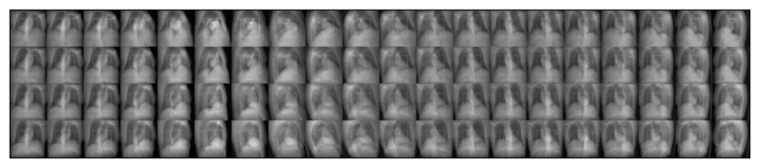
Fig 2a: DC-SPECT system geometry
Fig 2b: DC-SPECT system collimator assembly parts
Fig 2c: DRR from example CT
Fig 2d: Synthesized DC-SPECT system mpcDRRs corresponding to X-ray line integrals as in DRR

Slide 6
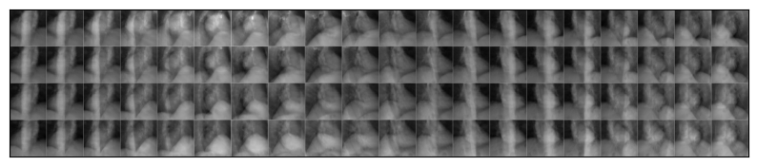
Wide FOV (2x) Synthesized X-ray DRRs for DC Cardiac SPECT Camera
Full FOV (1x) Synthesized X-ray DRRs for DC Cardiac SPECT Camera

Slide 8
